Slide 1
The Ultimate Blinkin Light
Introduction to Arduino Programming, ESP Boards, and Neo Pixels

Slide 2
Marcel Chabot
Software Development Lead
Maker
Not a teacher
I’m a total geek and I’m proud of it

Slide 3

First online Programming Class
Yes, you are guinea pigs.
Please let me know if things are going too fast/slow.
Greatly appreciate your feed back at the end of class.

Slide 4
Class Outline
Arduino Installation
Hardware Overview
Circuit Building
Code
Debug

Slide 5
Arduino Installation
Download
https://www.arduino.cc/en/Main/Software
Microsoft Store
Install
Add Boards
Add Libraries

Slide 6
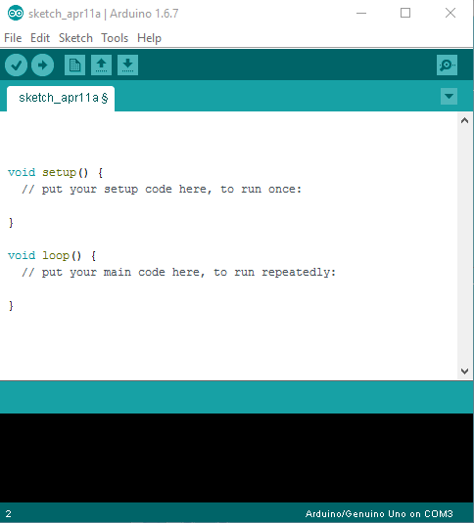
Arduino IDE
Used to write the code for the Arduino/ESP hardware
Global Variables go on top
Setup function happens once
Loop happens over and over again
Lower camel case variable names
// is a comment and doesn’t run

Slide 7
Adding Boards
Open Arduino
Select File > Preferences
Update the Additional Boards Manager URLs
https://arduino.esp8266.com/stable/package_esp8266com_index.json
Select Tools > Boards > Boards Manager…
Type ESP8266
Click the Install Button

Slide 8
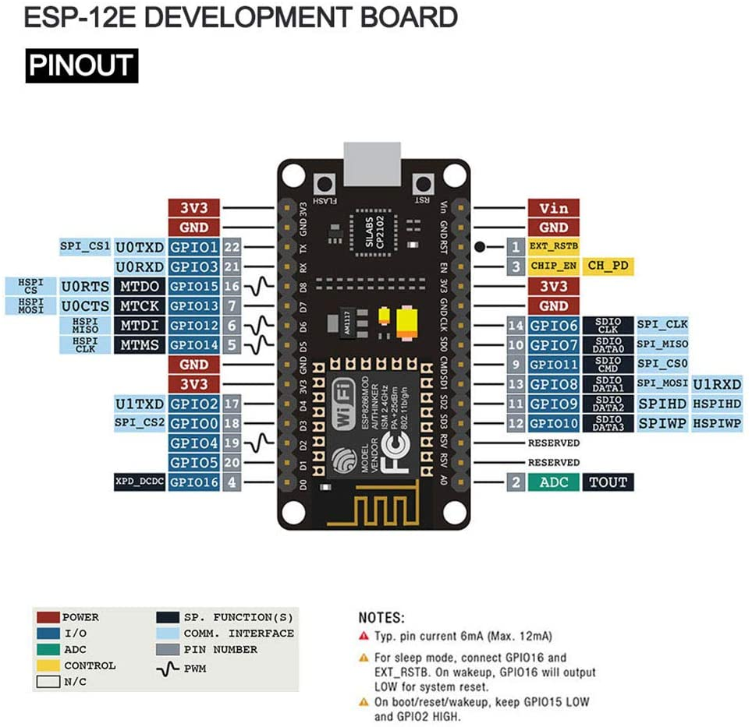
ESP Node MCU
Covers a large number of devices.
Digital In/Out (DI/DO)
Pulse Width Modulated output (PWM)
Analog Input (10 bit ADC)
RS-232/SPI/ICSP

Slide 9
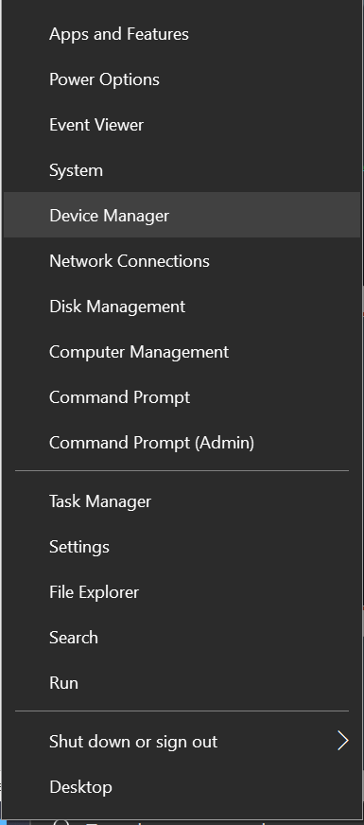
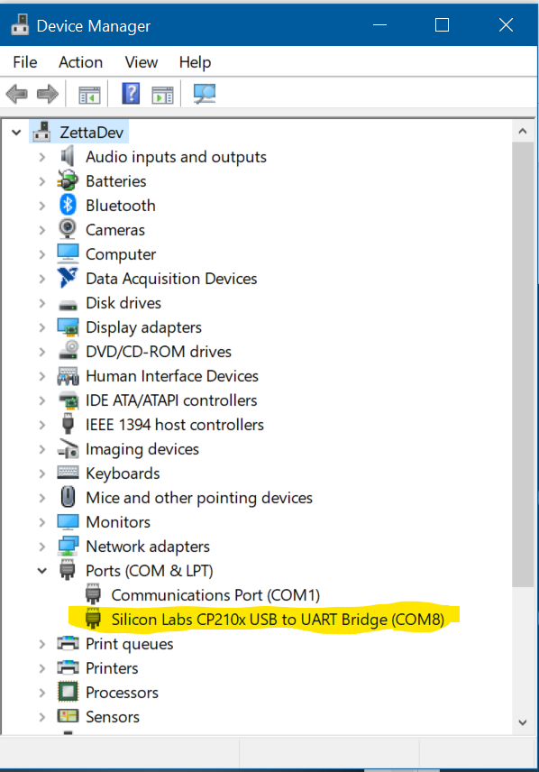
Plug in the MCU
Connect to the computer USB port.
Right click on the Start menu and select Device Manager
There should be a device listed under Ports
If not, the drivers may need to be installed from:
https://www.silabs.com/products/development-tools/software/usb-to-uart-bridge-vcp-drivers

Slide 10
Blinking LED Code
// the setup function runs once when you press reset or power the board
void setup() {
// initialize digital pin LED_BUILTIN as an output.
pinMode(LED_BUILTIN, OUTPUT);
}
// the loop function runs over and over again forever
void loop() {
digitalWrite(LED_BUILTIN, HIGH); // turn the LED on (HIGH is the voltage level)
delay(1000); // wait for a second
digitalWrite(LED_BUILTIN, LOW); // turn the LED off by making the voltage LOW
delay(1000); // wait for a second
}

Slide 11
Digital Input/output
Acts like little switches, either On or Off
Greater Than 3 volts = On
Less than 1.5 volts = Off
Mind the gap
Provides 40 mA of current sourcing or sinking
Digital Outputs can also output an 8 bit square wave

Slide 12
Analog Input
1 Analog output channels
10 bit resolution across 5 volts
Bits = Steps, 10 bits = 1024 steps
Resolution represents the smallest change the device can read
5 Volts / 1024 Steps = 0.0049 volts/step

Slide 13
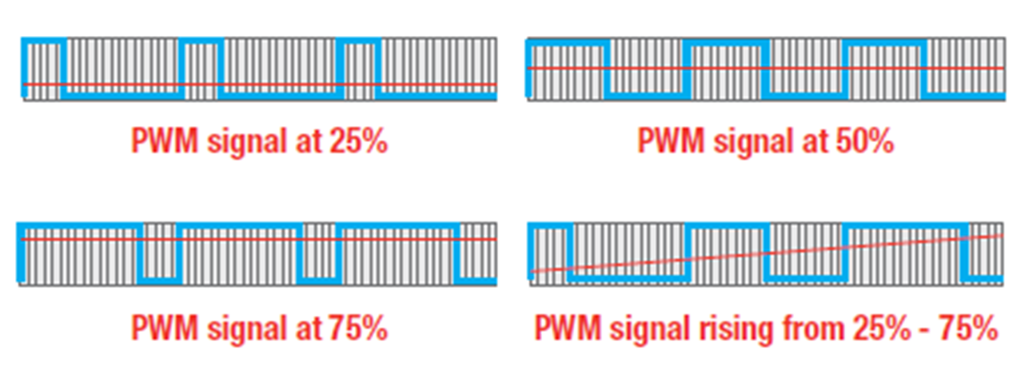
PWM
Pulse Width Modulation
Runs at a fixed clock rate
Expressed as percent time High
Pins marked with ~
LED?
Motor?
Piezo?

Slide 14
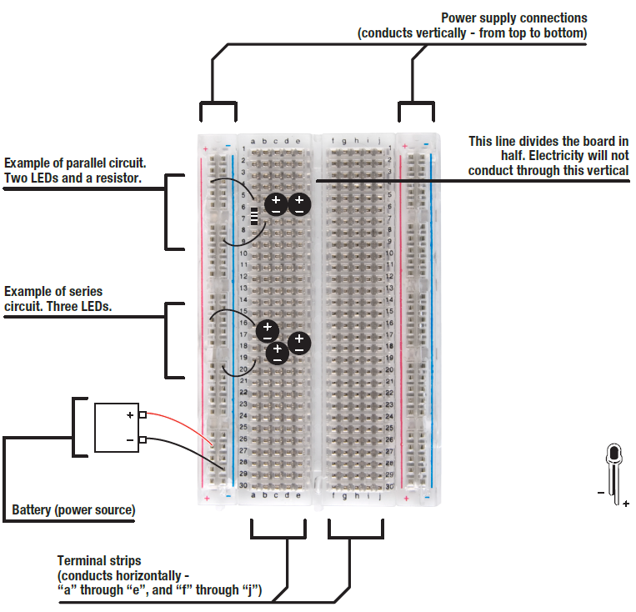
The Breadboard
The power lines, 2 on each edge, run vertically
The prototyping lines run horizontally
No lines cross the center gap

Slide 15

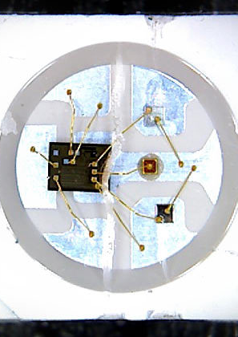
NEOPixels
Initially packaged and sold by Adafruit.
One Wire system (I know there are three)
Used to cover a large variety of self addressing LED systems.
WS2811, WS2812, WS2812B, SK6812
Very timing dependent

Slide 16
Wiring Considerations
VIN is connected to the voltage from the USB Port
Limited current available when run from USB
VIN can be used to power the MCU.
When powering the MCU and the WS2811 string the current is limited by the wiring and the power supply.
When using a power supply or battery add a 1000 µF, 6.3V or higher capacitor between the power leads.
DON’T USE VIN EXTERNALLY AND USB.

Slide 17
Power to the Pixels
The normal usage: Pixels X 20ma / 1000
50 x 20ma/1000 = 1Amp minimum
The full power usage: Pixels x 60ma / 1000
50 x 60ma/1000 = 3 Amps minimum
The MCU can only do about 500ma, so we will need to watch out.

Slide 18
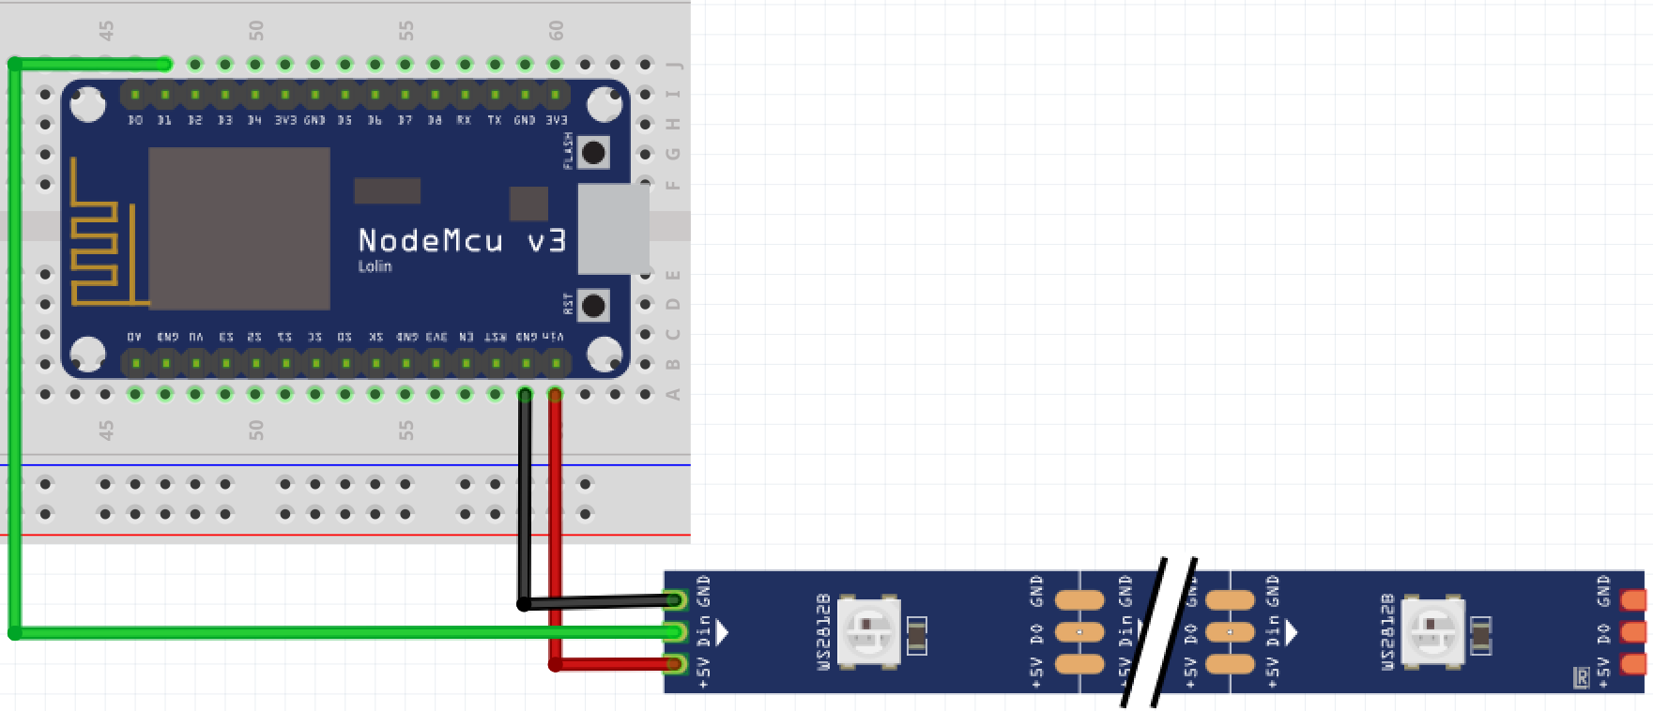
Wiring up the Lights

Slide 19
Libraries Make Everything Better
Select Tools > Manage Libraries
Search for FastLED
Install the FastLED library

Slide 20
Coding our first Blinking Light

Slide 21
A little more Code
Variables
Boolean 0, LOW, false, 1, HIGH, true
Int -32768 to 32767
Char a character
Declare
Assign
If / Then / Else
While
For

Slide 22
If / Then / Else
if(val == 1) {
digitalWrite(ledPin, LOW);
}
else if (val == 2) {
digitalWrite(ledPin, HIGH);
}
else {
digitalWrite(errorPin, HIGH);
}
Performs a comparison
Results must be True or False
Condition is after the if in ()
The Action is after the condition in {}
Change together with else if
Default condition with an else
==, !=, >, <, !
&&, ||

Slide 23
Repetition
Allows you to perform actions repeatedly
Controlled with variables
Always contains a header and a body with { }
You can loop inside a loop!
Loop
While
For

Slide 24
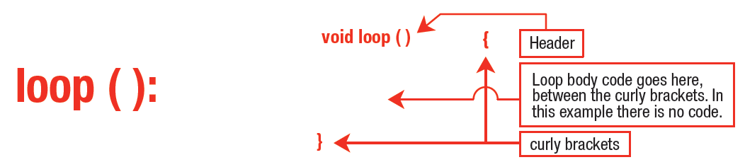
Loop

Slide 25
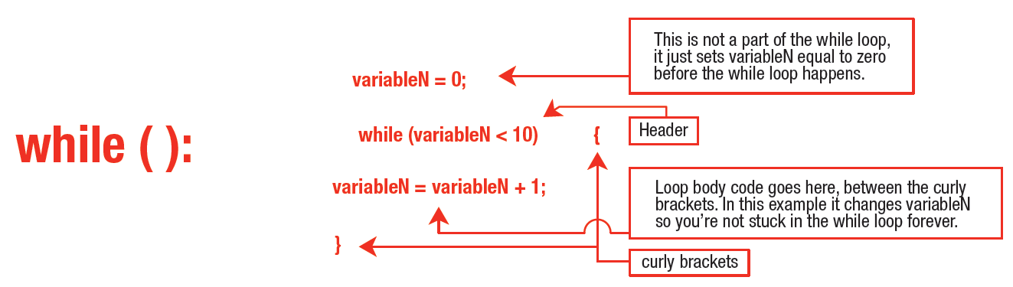
While

Slide 26
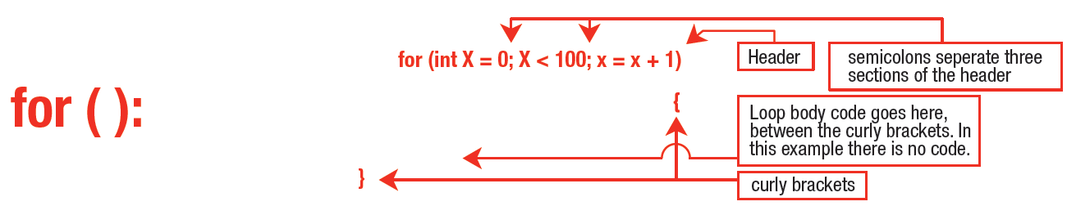
For

Slide 27
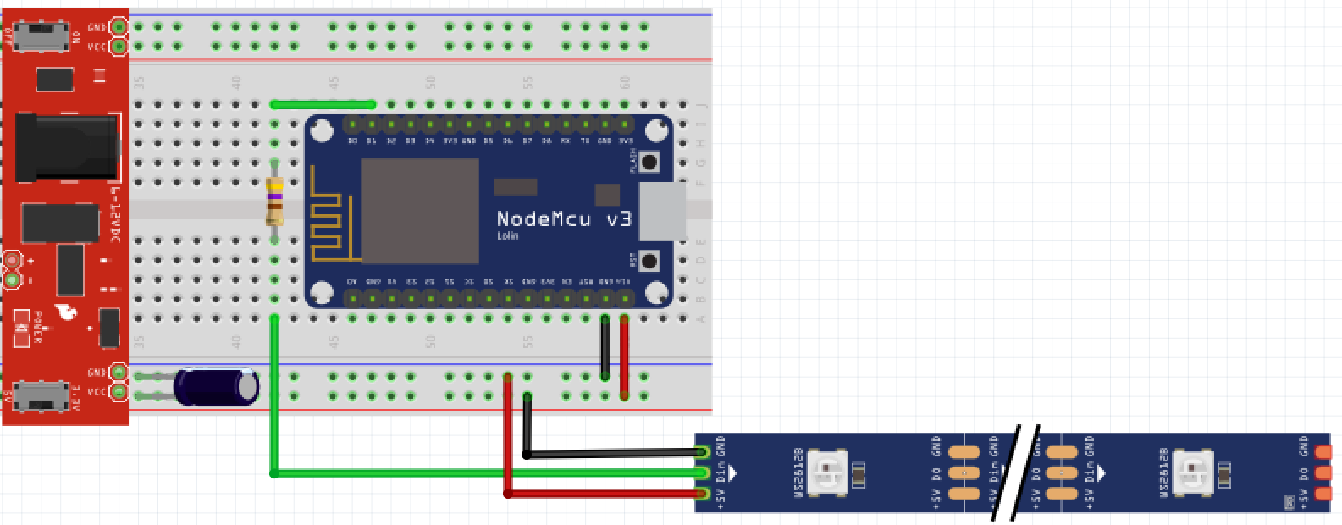
Going BIG

Slide 28
Sources for Ideas
https://www.tweaking4all.com/hardware/arduino/adruino-led-strip-effects/

Slide 29

What about Wifi?
IoT Config for WiFi connections
Showing a page
Interacting with the ESP through a web page
Notes:
https://github.com/prampec/IotWebConf

Slide 30
Libraries Too Add
Select Tools > Manage Libraries
Search for IoTWebConfig
Install the IoTWebConfig library

Slide 31
IotWebConfig
Starts the device as a WiFi AP at 192.168.4.1
Hosts a configuration web page for WiFi connection details
Can be configured to allow additional parameters
Automatically switches to configured WiFi, and fails back to AP Mode
Includes web page hosting resources

Slide 32
Examples for Today
Config Page
Color Picker
Pattern Picker
Parsing Query Strings

Slide 33
Important Concepts
Most Patterns are Loops and must happen with the Loop routine.
Web interaction is a one shot and must “message” the loop to do work.
Don’t judge the ESP platform by my HTML.

Slide 34
Things for Tomorrow
Web Control Via Web Service
Web Control with Ajax interactive pages
Home system integration
www.ESPHome.io
www.home-assistant.io
www.openhab.org
www.nodered.org

Slide 35
Thank you!

